Slide 1
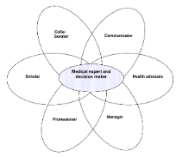

The Role of the
Learning Disability Physician – secondary care
Dr Charly Annesley
Consultant Learning Disability Physician, North Middlesex Hospital, London
Course lead for PGCert in Learning Disability Medicine, Edge Hill University
Learning Disability Professional Senate, 07/09/2026

Slide 2
Overview
Review of evidence – a gap in the market
What is learning disability medicine?
Establishing a service
  Locally
  Nationally
Cases
Critical care outcomes
Teaching
Audit and Governance
Q&A
Notes:
First and only consultant learning disability physician in the UK
- Filmed in 2022 by the BBC as an example of best practice in this field
Set up and lead a post grad curriculum in learning disability medicine
Co-authored national guidelines for management of CAP in PWLD
Staff award for outstanding contribution to patient care and experience
Linda McEnhill award for excellent care (teamwork) at the end of life
NB – NOT a perfect service

Slide 3
Background
Well known to the Senate
Avoidable deaths
Lack of holistic model of care
ID psychiatry + GP
Transition from paediatrics

Slide 4
LeDeR
Problematic aspects of care
  Delays in diagnosing and treating illness
  An apparent lack of care
  Unsafe discharges from hospital
  The quality of care received by the person
  Assumptions made about the person
  Delays in appropriate investigations being carried out
  Delays in the timely provision of medical care
  Delays in processes related to the Mental Capacity Act
  Lots of areas in which a medical consultant can have significant impact

Slide 5
What is learning disability medicine?
Person centred healthcare for people with a learning disability
Recognition of the potential for complex physical health and atypical presentations
Consider psychosocial factors
Consider communication for the person with a learning disability
Consider health inequalities
Evidenced based approach, acknowledging data gaps
Sound clinical leadership
In the context of the wider MDT, apply in-depth knowledge, understanding, and skills to synthesise, apply and evaluate a contemporary holistic person-centred management plan, advocating for individual human rights and using relevant legislation

Slide 6
Establishing a Learning Disability Physician service
Established 2019, North Middlesex University Hospital, London
2 PAs/week (1x DCC, 1x SPA)
Liaison model for people admitted to hospital
Working in conjunction with hospital learning disability liaison nurse
Focus on complexity, leadership
Average 1hr for new patient
Caseload 10-20 patients per week
  ~250 admissions per year (96% emergency)
  LOS 13 days (1-131)

Slide 7
Developing the role locally
Aims
  Working in conjunction with the learning disability liaison nurse
  Holistic reviews focusing on medical complexity, polypharmacy, advocation and supporting best interest decision making
  Particular focus on conditions with high mortality e.g. constipation, dysphagia, epilepsy
Challenges
  Needs more allocated time – would be a busy full time job
  No outpatient clinic – GPs cannot refer to me directly
  COVID-19
  Busy day job – I previously managed a geriatric medicine ward; now LTFT post second maternity leave
  Lack of referrals, awareness- online flag system imperfect – this has improved over time
  No resident doctor presence
  Very limited administrative support

Slide 8
Establishing the role nationally
Working with NHSE WTE (HEE)
Political drivers – LD&A Programme; Building the Right Support 2014; CIPOLD 2013
  NHSE Regions
  Integrated Care Boards (ICB) – commissioning
  Acute (124) and Community Trusts
Education
  Establishing post-graduate training
    PGCert with RCP via Edge Hill University commenced February 2023
Notes:
Diagnosis functional

Slide 9
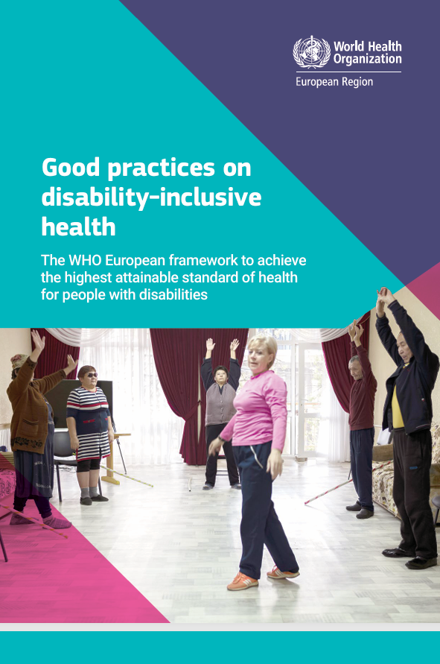
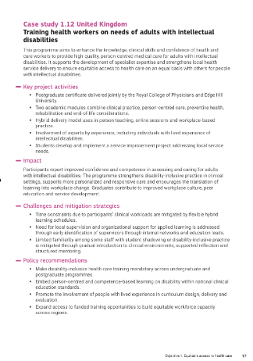
https://iris.who.int/server/api/core/bitstreams/6f890c17-4860-43ce-aaf3-1eb55a5020e1/content

Slide 10
Cases – redacted

Slide 11
Critical care local outcomes – redacted for sharing
Notes:
No inarc data on learning disability

Slide 12
Non CRC outcomes
– redacted for sharing

Slide 13
Teaching
Targeted medical teaching to different grades, departments
  Proactive
  Reactive e.g. governance issues
Included in local NHSE teaching pilot on generalism
Trust wide initiative during learning disability week
  Dedicated and tailored to each clinical area throughout the week
PGCert via RCP/EHU

Slide 14
Audit- redacted for sharing
E.g. DNACPR audits
Analgesia

Slide 15
Governance
Complaints, safeguarding
Annual reports
Graph redacted for sharing

Slide 16
Academic/ research/ collaboration
BTS guidance on CAP in people with a learning disability CAP in people with learning disability
Guidance on constipation Laxative use in adults with intellectual disabilities: development of prescribing guidelines | BJPsych Open | Cambridge Core
NHSE MCA guidance NHS England » Guidance to support implementation of the Mental Capacity Act in all NHS commissioned settings for adults with a learning disability
NCEPOD A review of the quality of care provided to adults with a learning disability when admitted to hospital acutely unwell.
RCP conferences

Slide 17
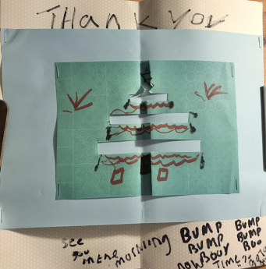
Thank you for listening.
Qs in the chat or email

