Slide 1


‘Learning Together’
Dr Alison Tavaré
NCEPOD Clinical Co-ordinator
GP by Profession
Clinical Lead at Health Innovation West of England
Co-chair RCGP Learning Disability Special Interest Group
Learning Disability Senate
September 7th 2026

Slide 2


NCEPOD
National Confidential Enquiry into Patient Outcomes and Death
Want to improve the care given to patients
Clinicians make the suggestions for areas for improvement
Topics chosen by the NCEPOD steering group
Not audit or research but a snapshot of what is happening
  Hospitals give information on services, staff training etc
  Clinicians look at the notes; both those who have looked after the patient and colleague who look at anonymised notes
  Focus groups and patient surveys
  Online professional surveys

Slide 3

What did we look at?
No previous study into variation of healthcare delivery in the acute sector
Aim:
The objectives of the study were to identify avoidable and modifiable factors associated with poor quality of care in patients with a learning disability admitted to hospital when acutely unwell.
Who:
All patients with a learning disability aged 18 years and over, who were admitted to hospital as an emergency between 1st July and 30th September 2024 inclusive.
Data:
12,883 patients identified
1,040 patients included for further review by 666 clinician questionnaires, 366 case notes reviewed and 144 primary care questionnaires
199 hospital organisational questionnaires
>800 health and social care professionals completed survey
32 patient surveys and 50 carer surveys
Notes:
Patients were identified retrospectively
using F70-F79 ICD10 codes in any position at discharge and/or learning disability registers within the
acute trust/health board
Excluded Patients admitted as a day case, including same day emergency care (SDEC) admissions, as there would
not be enough data to review.
Mean age was 53 and the median was 55-57 compared to mean age of 69-71 in general population and median age of 70-72
Most patients (95%) in study were taking medications prior to admission to hospital with 32% patients prescribed ten or more medications. In nearly 60%, these were psychotropic medications (unknown in 5) Nearly 20% patients who were receiving antipsychotic medication

Slide 4
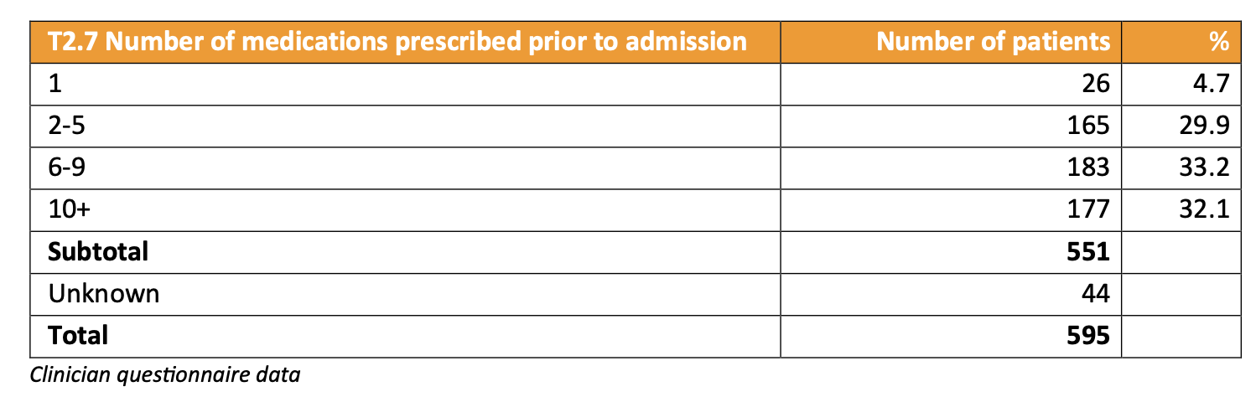
Medications
Most patients (95%) in study were taking medications prior to admission to hospital with 32% patients prescribed ten or more medications. In nearly 60%, these were psychotropic medications (unknown in 5)
Nearly 20% patients who were receiving antipsychotic medication
17% patients on antidepressants was lower than in national data, which identified 22% of people with a learning disability on antidepressant medication
Notes:
levels previously reported in 2022/23, indicating that 14.4% of patients with a learning disability were prescribed antipsychotics

Slide 5
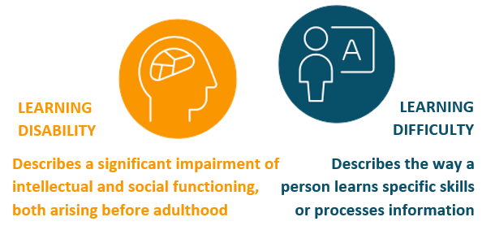
1
Accurately RECORD a PERSON’s Learning Disability in THE patient NotEs and on Learning Disability REGISTERs/ LISTS.
119/366 (32.5%) patients were described as having a learning difficulty rather than a learning disability and the two terms were often used interchangeably
One reviewer noted “shortened to ‘LD’ so not sure what they mean” and another noted that the terms were “used interchangeably in the same assessment by the same medic”

Slide 6
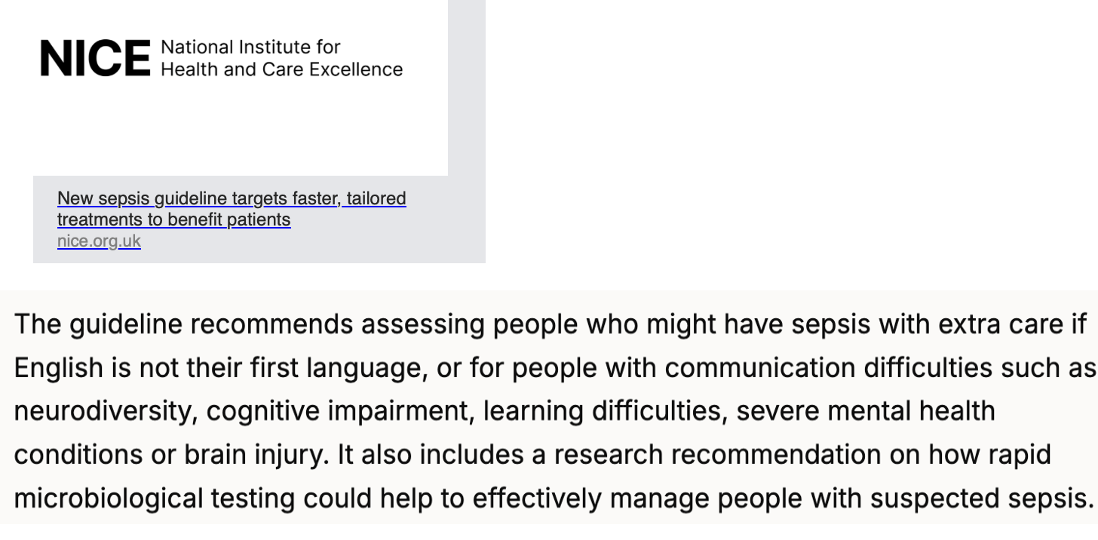
NICE Sepsis guidance 2025
Contacted via Ken Courtney and wording changed

Slide 7
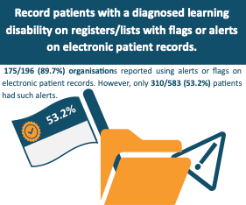
Recording and sharing a learning disability
Do the admission team know someone has a learning disability when they arrive at the front desk?
Are there alerts or pop ups on the patients EPR?
Is anyone such as the learning disability team notified that someone with a learning disability is in hospital?
Are patients identified as having a learning disability on the hospital dashboard?
How many people with a learning disability were admitted to hospital but were not identified as the diagnosis was not coded or they were mis-coded as having a learning difficulty?

Slide 8
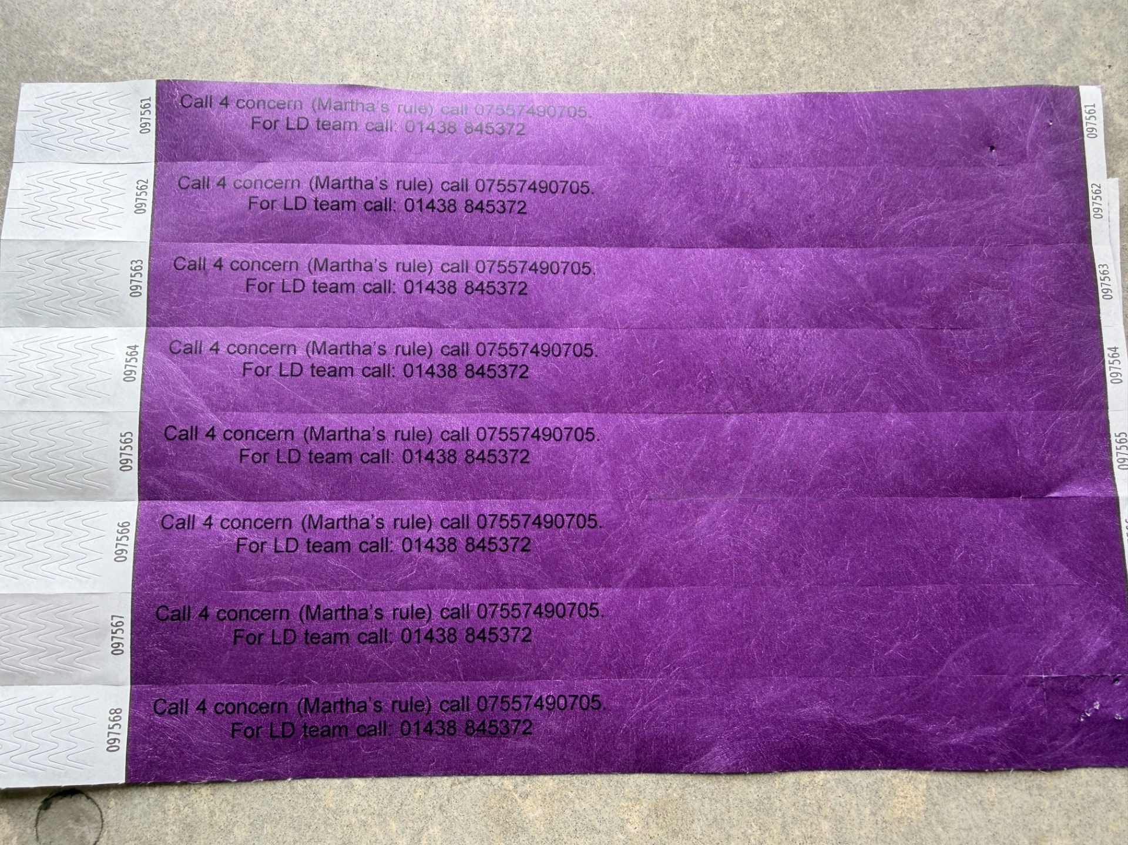
Purple Wristband
Notes:
Thanks to Alex Barclay and team

Slide 9
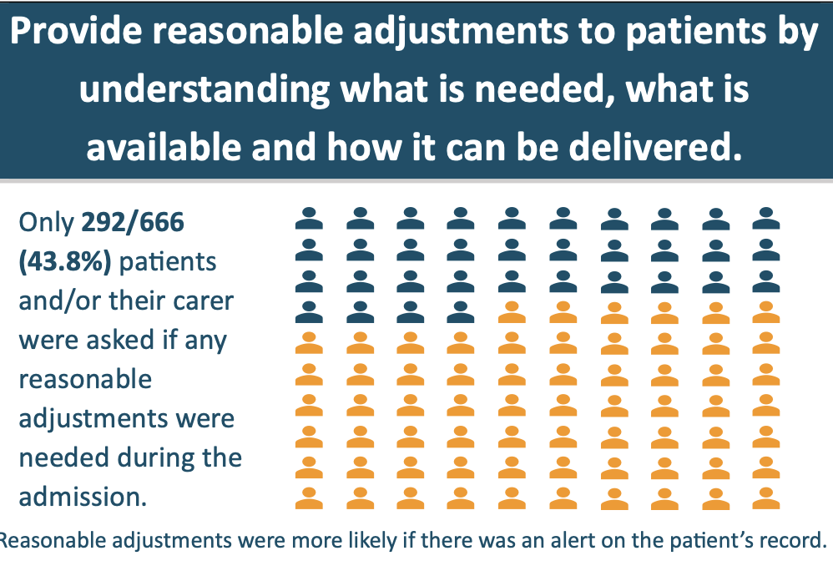
2
Assess and implement reasonable adjustments for patients with a learning disability.
The effective implementation of reasonable adjustments depends on an awareness of individual needs
Reviewers found that reasonable adjustments were much more likely to have been made if the carer was involved throughout the admission (~40% ) but often carers not asked if any needed
One reviewer noted “the carer knew the situation well, reasonable adjustments were made without a second thought and worked closely with the family
Documented evidence of reasonable adjustments being made for 159/366 (43.4%) patients however often made inconsistently for 77/366 (21.0%)
Notes:
Background: Reasonable adjustments are the removal of barriers to care and are required under Equality Act of 2010
May be organisational eg disabled parking and accessible toilets and personal eg personal items such as toys or quieter room.
CQC ‘experiences of being in hospital highlighted people found it difficult to access care if reasonable adjustments to meet their individual needs were not made
Can be proactive ie know what is needed but also ask if others
1.Asking about RA reviewers ~43% and carers similar
2Making RA; TEACH most likely help and communication. Not just personal lacking also organisation eg only ~8% orgs always offer accessible information. However aware that with pressure on system not all RAs can be offered eg quiet space in busy ED or LD service overnight. RA more likely to be made it carers involved in discussions
3. Sharing RA; . Only 116/199 (58.3%) organisations had a standardised approach to identify reasonable adjustments for patients with a learning disability. OQ: nearly 70% on digital record,~ 40% on digital admin system, ~30% in paper record, 20% had a pop up in acute hospitals electronic helps and reasonable adjustment flag will enable this to happen across organisations mentioned by 13% orgs.
Examples:
Only 8% organisations consistently shared information in accessible formats and inconsistent for 70% ?? Potential for future to have national resource bank
Man with suspected PE; refused CT even though had been managed previously with reasonable adjustments: anticoagulation without confirmed diagnosis
Patient able to wait in room and not in lounge with others
Of the 24 patients who experienced a delay in the delivery of care, ten did not have any reasonable adjustments made during their admission; reviewers thought that
appropriate reasonable adjustments may have prevented these delays

Slide 10
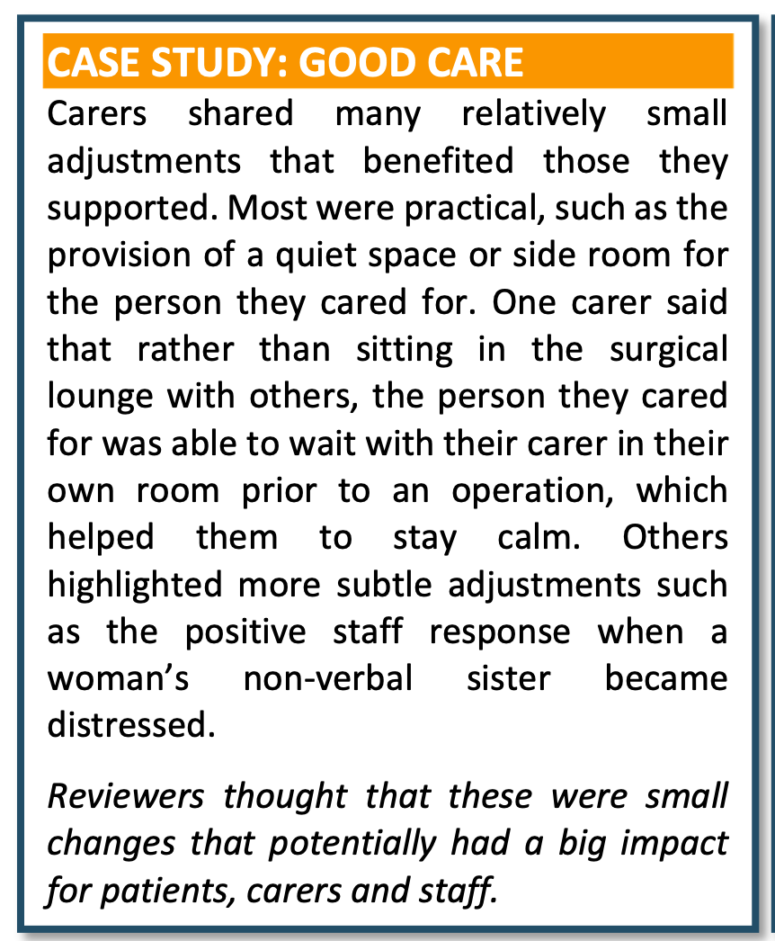

Reasonable adjustments
What reasonable adjustments are available in your organisation?
Are there reasonable adjustments available in your department eg noise cancelling headsets Iin ED?
How do you know what reasonable adjustments could help the person for whom you are providing care?
Are there carers who might be able to share practical solutions?
How do you share what reasonable adjustments help?
Are you using the RADF Reasonable Adjustment Digital Flag?
Notes:
https://digital.nhs.uk/services/reasonable-adjustment-flag

Slide 11

3
Use decision support tools to aid healthcare professionals when assessing mental capacity in patients with a learning disability.
A person with a learning disability should not be presumed to lack mental capacity to make health related decisions.
Reviewers reported formal mental capacity assessments were made
consistently for 104/366 (28.4%),
inconsistently for 33/666 (9.0%) and
not at all for 229/366 (62.6%) patients
121/229 (52.8%) of patients who did not have a formal capacity assessment should have had one
A decision support tool to support mental capacity assessments was available in ~95% hospitals
Of the 277/475 HSCP who assess mental capacity only 60% felt confident to do so
Concerns were expressed by reviewers that if patients refused treatment, the treatment or intervention was often stopped without consideration of mental capacity or best interests
Notes:
Background; Mental capacity Act start with the same assumption that everyone has capacity to make a decision unless find otherwise so cant assume that people with a learning disability doesn’t have capacity as its decision specific eg very different saying if want a cup of tea or agreeing to investigations. Some decisions may be straightforward but others more complex and capacity should be assessed when there is reason to doubt someone’s capacity to make a specific decision at at a specific time
Did assessments take place?
Decision support tools available but lack of confidence amongst HCSP even if part of their role. Why is this and is this something that can be investigated. Know that 70% of decisions are recorded on electronic forms, nearly 50% paper and nearly 20% variable. If had had recent training more confident
Clinicians and reviewers made suggestions for improvements. NHSE has developed resources but currently paper based; could there be an electronic tool as part of the EPR supporting decision making and easily accessible by others. Area for research to fully understand lack of confidence
Best interest decisions: 76/366 (20.8%) patients who refused or declined investigations or treatment and concerns were expressed by reviewers that if patients refused treatment, the treatment or intervention was often stopped without consideration of mental capacity or best interests
Family and carers cannot make decisions on behalf of anyone else but can be part of the discussions
Restrictive practice for 67/366 (18.3%) and not underpinned by DOLs in 39/67. Considered all chemical restraint appropriate
Surgery; not specific Q re consent for surgery but formal assessment of capacity at any point during the admission for 36/76 patients who underwent surgery
IMCA in 98% hospital and working hours
Surgery For patients who are unable to give consent, a Consent Form 4 is used which requires a statement of a best interests discussion as well as a documented mental capacity assessment. A Consent Form 1 is for patients who have capacity and will include some patients with a mild learning disability. It was not documented which form was used

Slide 12
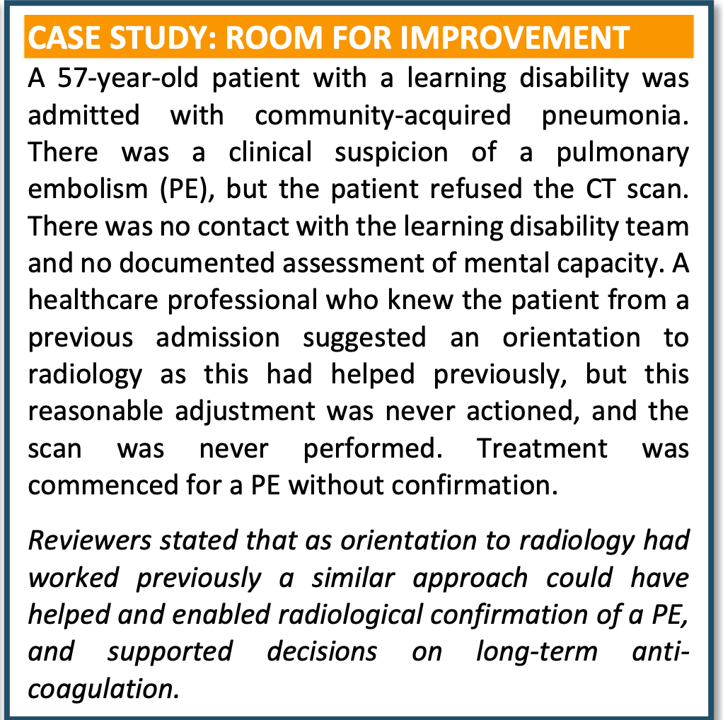

Mental capacity and reasonable adjustments:
Room for improvement
Do you feel confident assessing mental capacity?
How do you record your decisions?
Are decisions part of a patient’s electronic patient record?
Do you have access to a decision support tool?
https://www.england.nhs.uk/long-read/guidance-to-support-implementation-of-the-mental-capacity-act-in-acute-trusts-for-adults-with-a-learning-disability/
Notes:
QR code

Slide 13
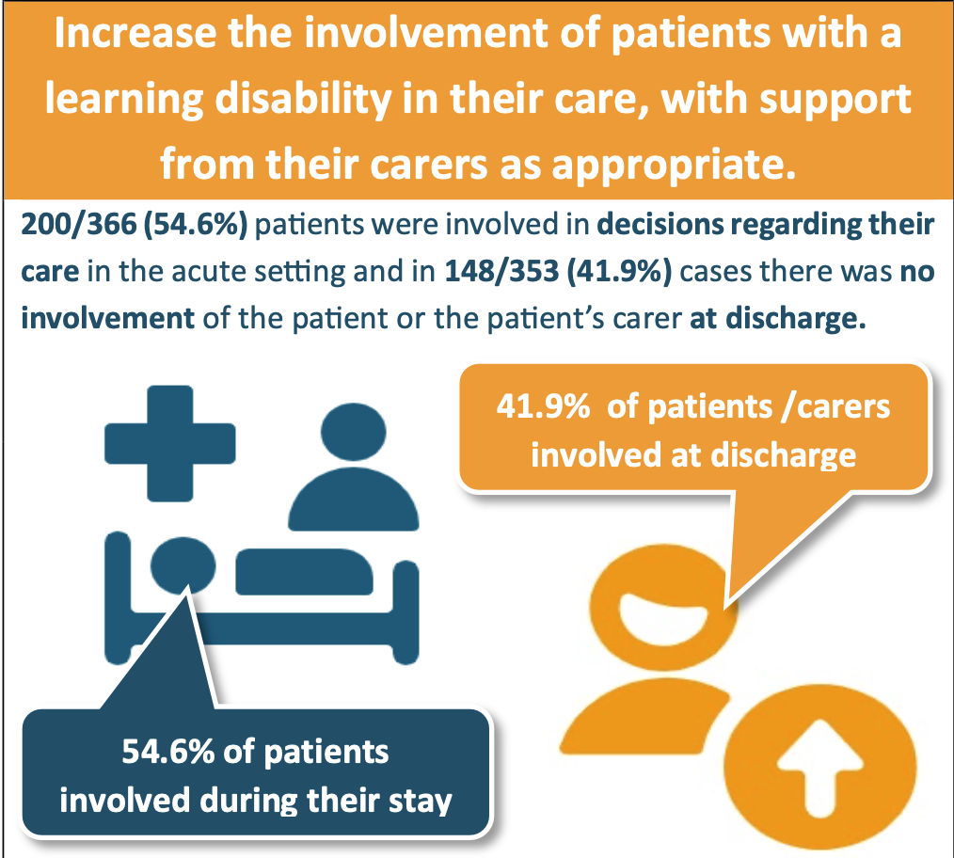
4
Consistently and continuously involve people with a learning disability in their care during a hospital admission. This should be from the point of arrival through to discharge.
Carers were involved in (168/366 (45.9%) but this involvement was inconsistent in around a third of cases reviewed
At discharge, 148/353 (41.9%) cases showed no involvement of either the patient or their carer in planning ongoing care. 115/519
(22.2%) patients were readmitted within 30 days of discharge, which was more than three times higher than readmission figures for people without a learning disability
For 67/115 (58.3%) patients the readmission was related to the original admission under review
Notes:
And where involvement was identified, this was inconsistent in just under half of cases
Hospitals feel they provide support to carers but in reality it is not happening (e.g. carers passport, access to toilet, meals, staying overnight)
Carers improved the quality of care
Care twice as likely to be rated as good
Challenges to gaining a full history was twice as likely when patients were unaccompanied
The data show that involving patients and carers improves information gathering, supports communication, and is associated with better overall quality of care
Other bits
Health passports – only around 30% of cases had evidence of a HC passport
Diagnostic overshadowing – twice as likely to be identified by reviews (7% vs 3%), presence of LD adversely affected care in around 1 in 5 cases (delayed diagnosis, delays to investigations, lack of reasonable adjustments)
DNACPR - The report identified examples where DNACPR decisions appeared to be influenced by the presence of a learning disability rather than a holistic assessment of the person's clinical condition, wishes, and prognosis

Slide 14
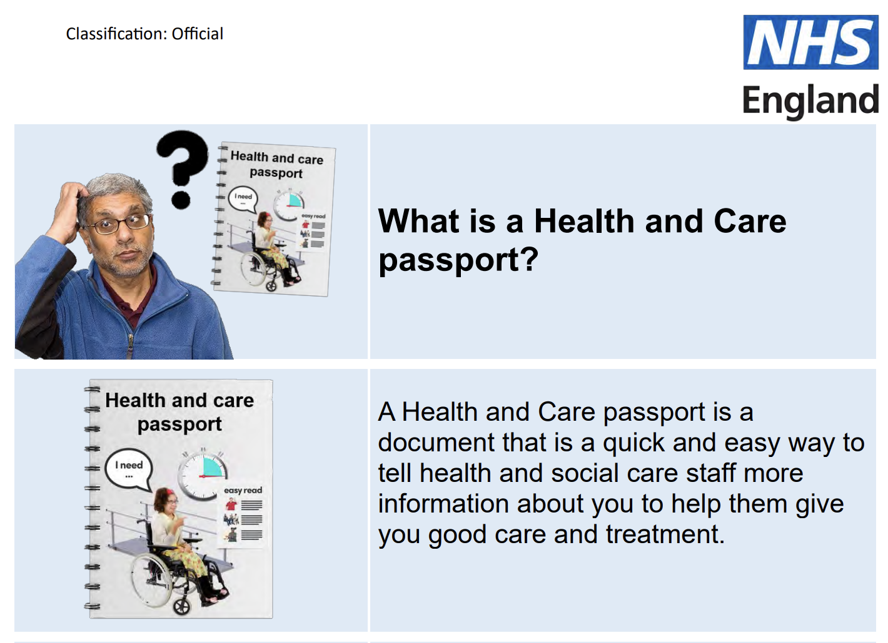
Putting patients at the centre of their care
Thorough initial assessment is required as many people with a learning disability have complex medical needs and take multiple medications
Standardised approach to assessment enables staff to understand a patients needs and address them
Clinicians stated checklists were used for`50% patients
Reviewers found only ~10% case records contained evidence that a standardised checklist had been used that baseline care needs were not recorded for ~25% patients
Is this an opportunity for a low cost potentially high impact way to improve care?
What about health and care passports? Only recorded as being available in 30% of cases and evidence for use in ~60% cases

Slide 15
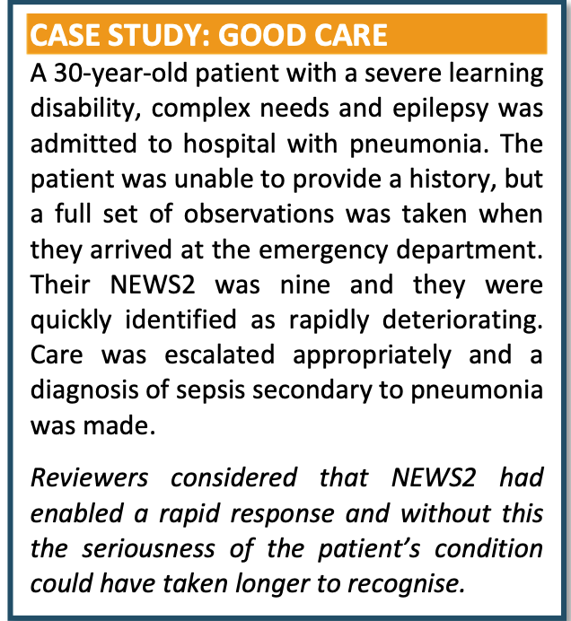
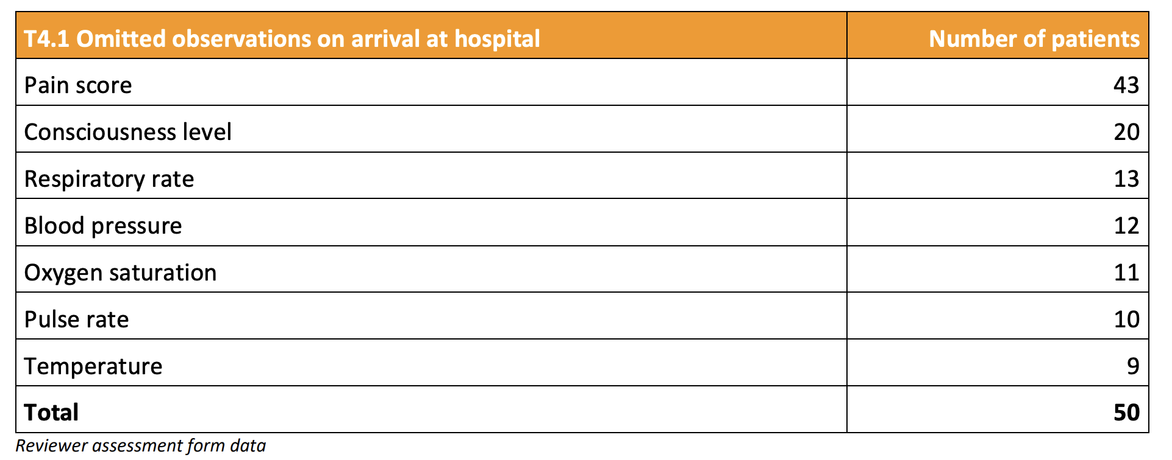
Delivery of care: observations
~ 15% of patients did not have a full set of observations on arrival at hospital
Most missed elements were consciousness level and respiratory rate
Pain was not recorded for about 85% of patients where observations had been assessed as incomplete
How do you decide if someone is in pain if they are unable to tell you?

Slide 16
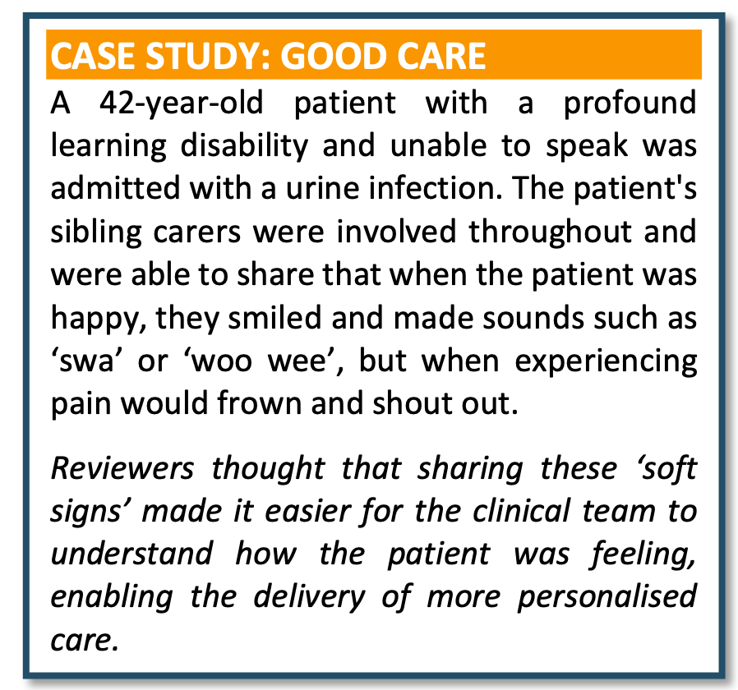
What about soft signs?
Carers possess valuable information about the individual and their health and may spot changes in behaviour, helping clinicians to identify and treat the acute illness and many families and carers or people with a learning disability will be able to describe how they know if someone is unwell as they are often very personal to the individual
Someone who is usually noisy may become quiet and subdued
Someone who is usually up and dressed doesn’t want to get out of bed
Someone who is usually happy to talk about their favourite hobby is not interested
Do you ask families and carers about soft signs?

Slide 17
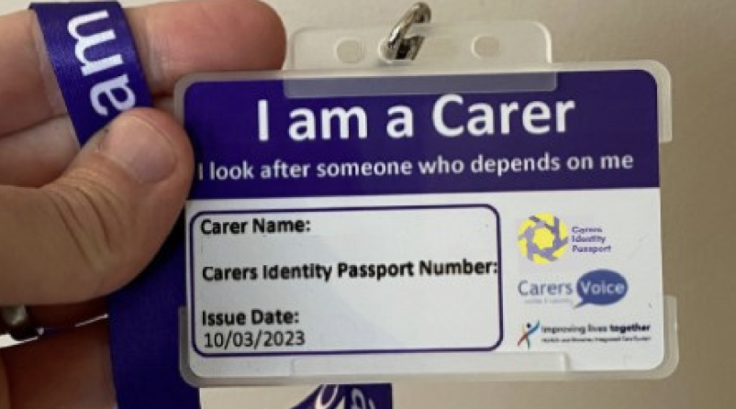
What do carers want?
Open visiting hours most common support offered by hospitals but in carer survey many felt unable to spend as much time as they needed or wanted with the person they look after
All (39/39) carer survey respondents who were able to stay in hospital with the person they looked after found it helpful
Very practical requests; access to toilets as have to leave person they care for to find a toilet
Parking top of the list but not prioritised by hospitals
Refreshments and meals; also practical as don’t have to leave person they are caring for
In ~60% hospitals there was informal approach to identifying patients’ carers
Do you have a carer’s policy in your place of work and if so what is provided?
Notes:
Car parking most requested by carers but bottom of the list for organisations who put open visiting hours at the top
Carers only offered support in ~30%

Slide 18
5
Commission local learning disability support services to enable equitable access to care for patients with a learning disability who attend or who are admitted to hospital.
This study highlighted that acute hospital learning disability services did not always exist and when then did, it was often just one person. This did not allow for a 24/7 service needed to care for patients admitted as an emergency.
Only 35/186 (18.8%) of hospital learning disability services were multidisciplinary, 69/186 (37.1%) were a single profession and 82/186 (44.1%) a single individual
127/186 (68.3%) of services operated during weekday working hours only, limiting support for emergency admissions. Only 95/536 (17.9%) of patients were reviewed by the learning disability service in the ED
Learning disability teams involvement was associated with better care (45% vs 27%)
Notes:
Many acute learning disability services lacked capacity and MDT input
Access was limited, particularly for emergency admissions – 116 should have been reviewed
LD team involvement was associated with better care
– communication / carer involvement, capacity assessments, staff education / upskilling and support and d/c planning

Slide 19
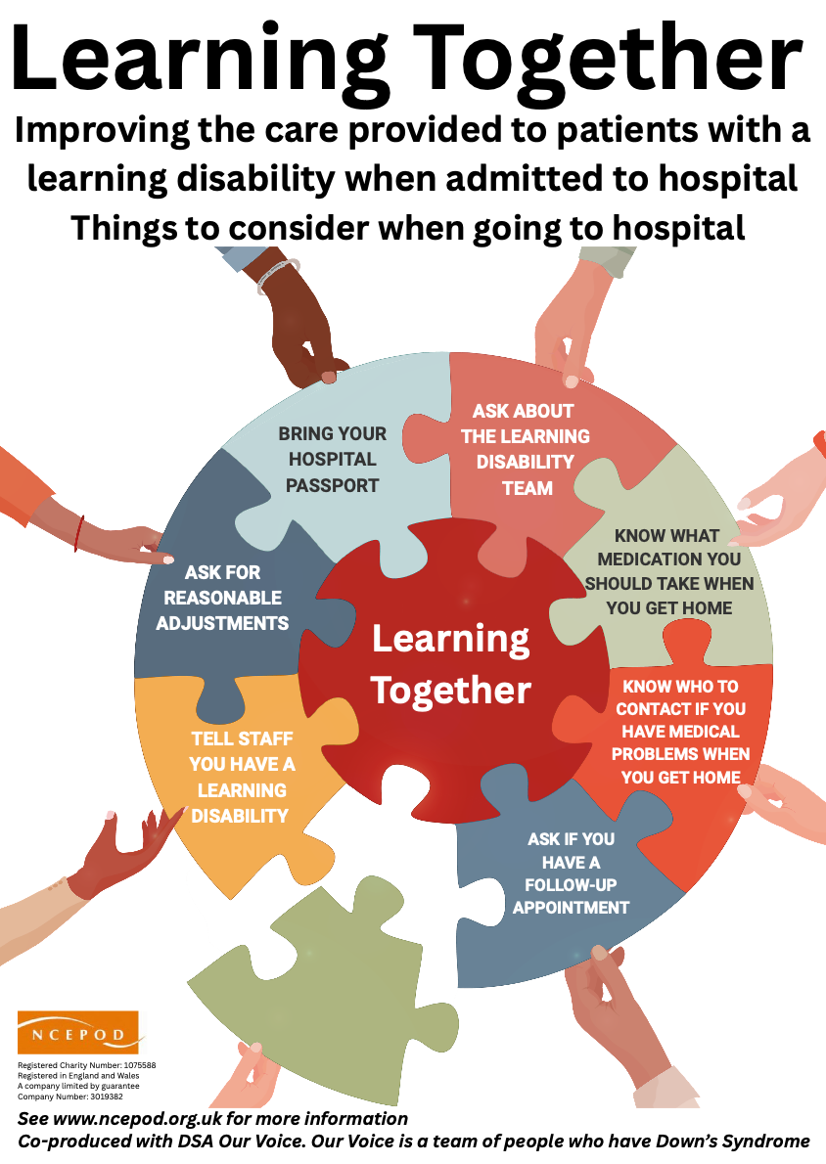
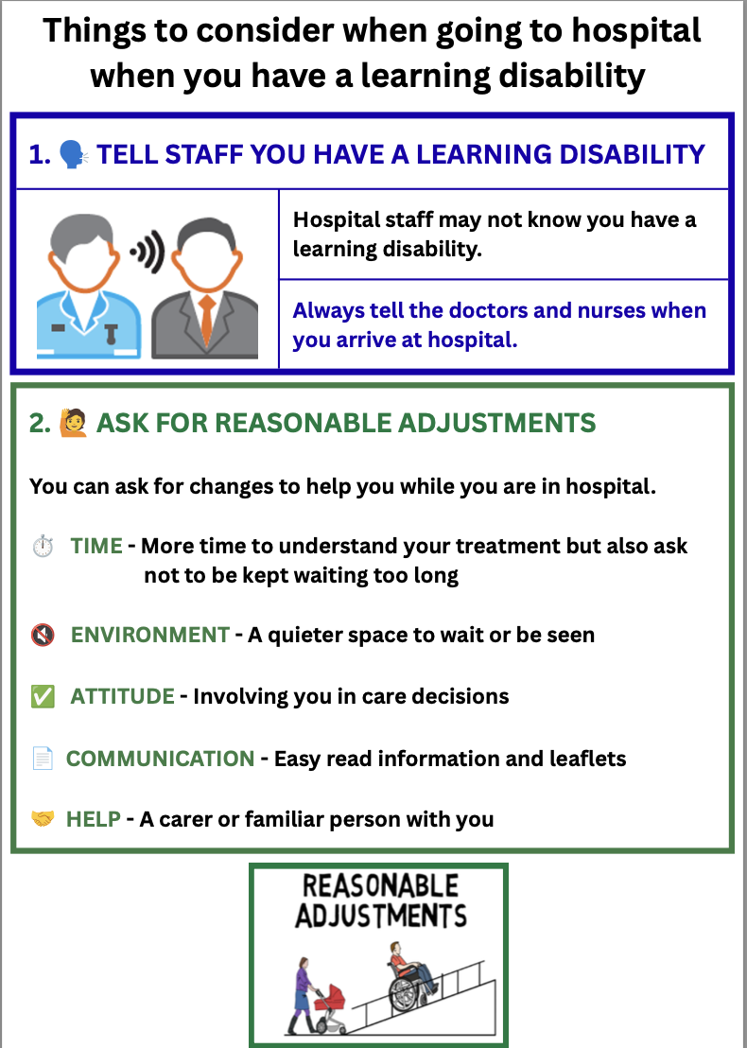
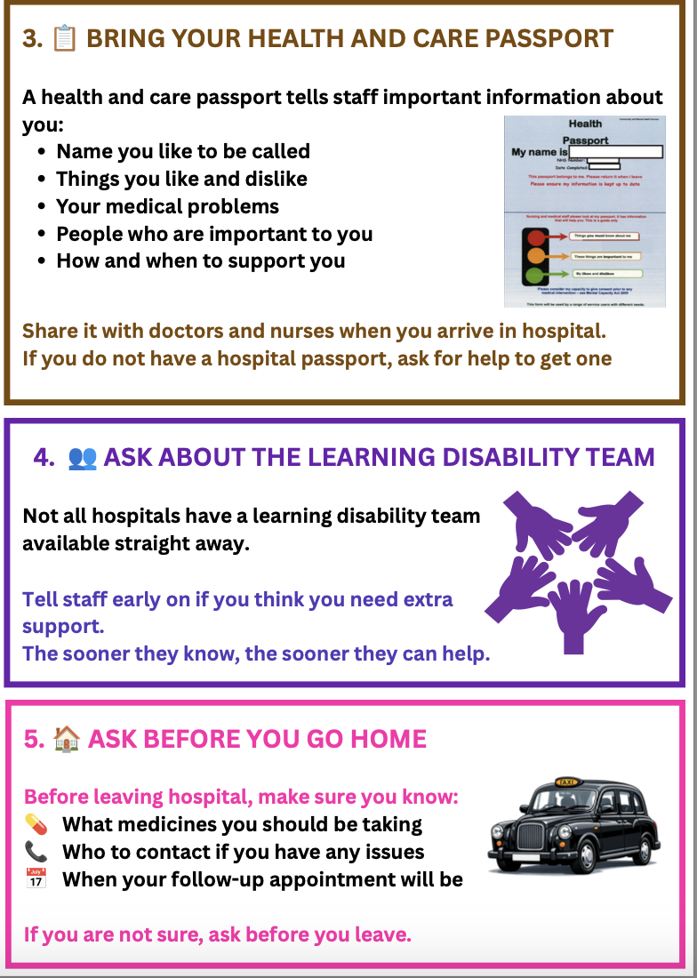

Learning Together: patient leaflet
Notes:
https://www.ncepod.org.uk/2026learningdisability/Learning%20Disabilities_Learning%20Together_Patient%20leaflet.pdf

Slide 20
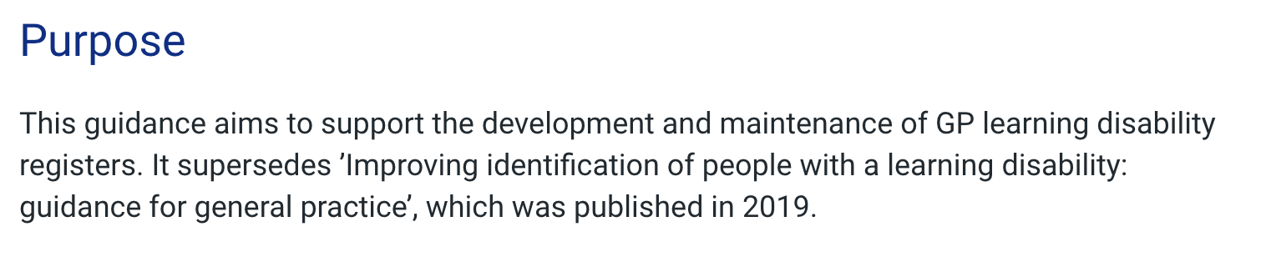
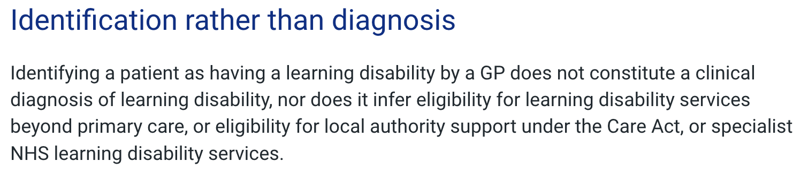
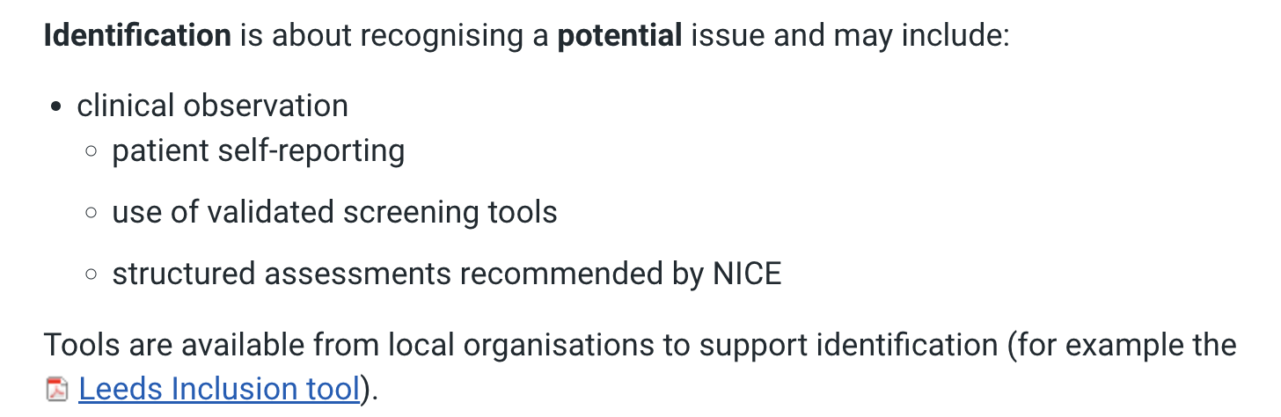

NHSE Guidance for general practice on improving identification of people with a learning disability
Notes:
https://www.england.nhs.uk/long-read/guidance-for-general-practice-on-improving-identification-of-people-with-a-learning-disability/

Slide 21

Reasonable adjustments
Notes:
Gav and Hilary will be on NCEPOD website

Slide 22




Acute care toolkits
Notes:
https://rcem.ac.uk/wp-content/uploads/2024/09/Learning_Disabilities_Toolkit_v2.pdf

Slide 23
‘Learning Together’: a summary
Identify, code and share that people have a learning disability
Raise awareness of importance and impact of reasonable adjustments
Need to upskill and improve clinician’s confidence to assess mental capacity
People with a learning disability and their carers should be at the centre of decision-making about hospital care
involvement of acute hospital learning disability teams to support patients and clinical teams improved the quality of care provided
Understanding and meeting the care needs of people with learning disabilities is everyone’s responsibility, not just that of specialist services
Notes:
Many acute learning disability services lacked capacity and MDT input
Access was limited, particularly for emergency admissions – 116 should have been reviewed
LD team involvement was associated with better care
– communication / carer involvement, capacity assessments, staff education / upskilling and support and d/c planning

Slide 24

Lots of resources…
Highlight report
Extended report
Easy read summary
Recommendations
Infographics
Patient leaflet
Commissioner guide
Slide set
Checklist
Audit tools
Driver diagrams
Fishbone diagrams
Resources
https://www.ncepod.org.uk/
Notes:
Needs checking and link to report

